Slide 1
EMER Regional Convention 2024

Slide 2
Save the Date
20.-22. September 2024
Mikulov – South Moravia, Czech Republic

Slide 3
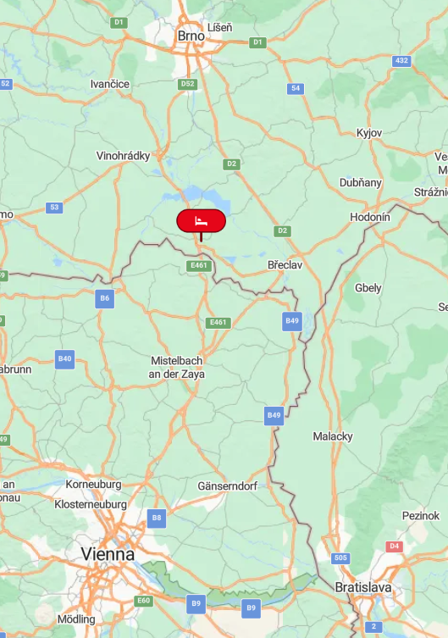
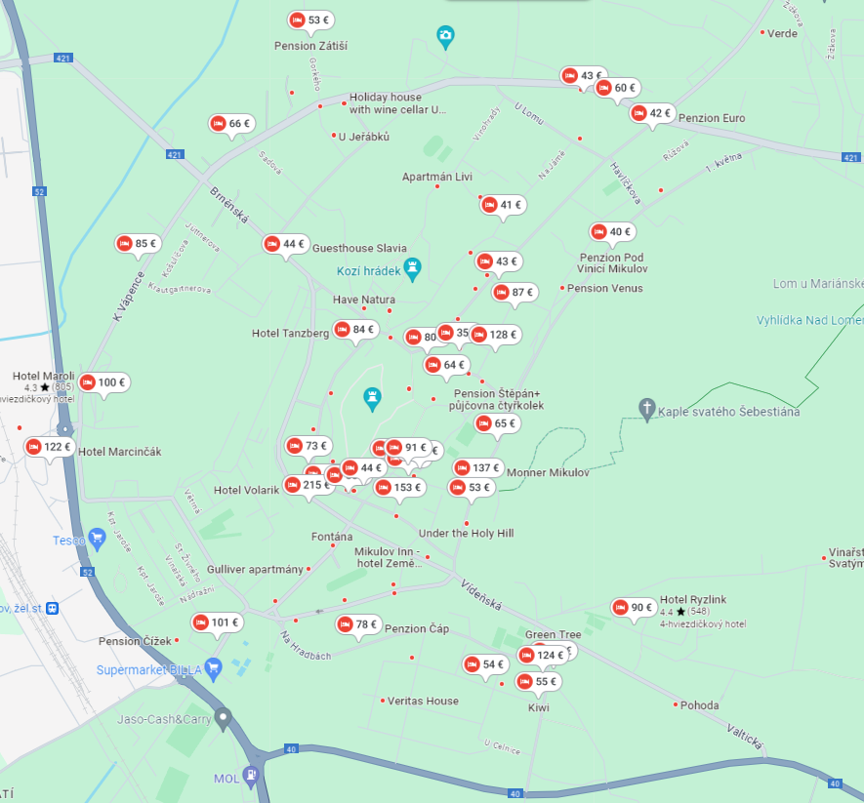
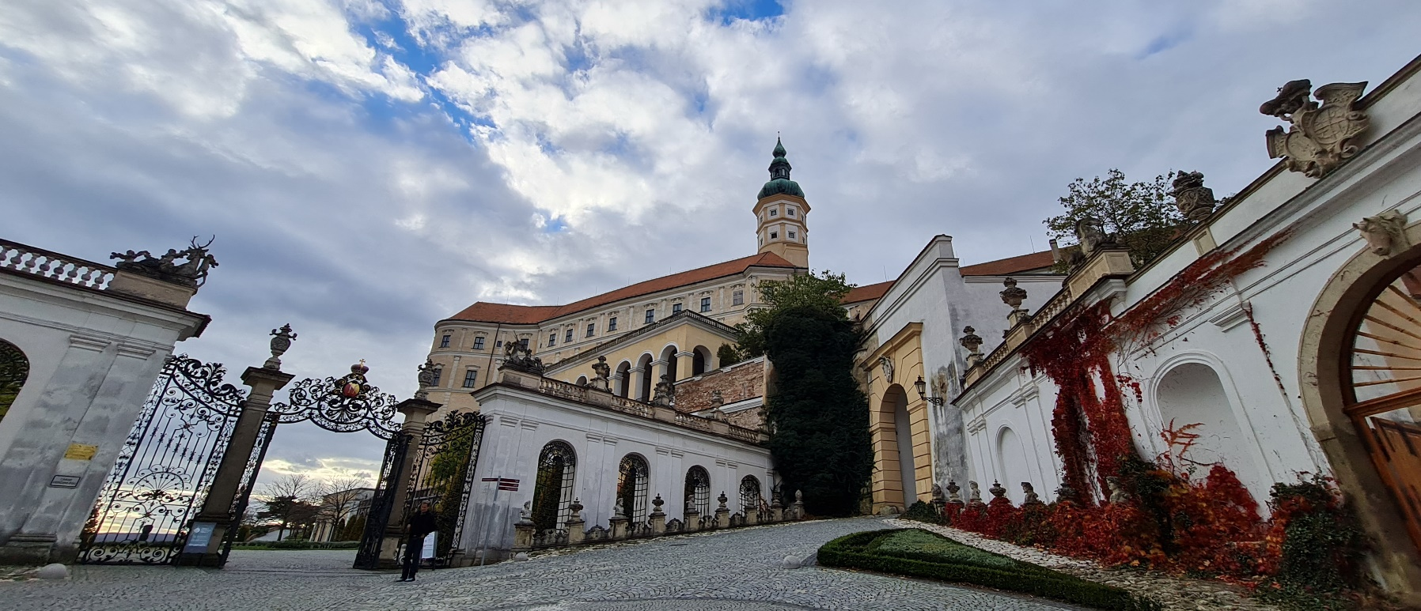
Venue
Hotel Galant **** https://galant.cz/hotel-galant-mikulov/
Trip - Advisor - https://www.tripadvisor.com/Hotel_Review-g277813-d1674749-Reviews-Hotel_Galant-Mikulov_South_Moravian_Region_Moravia.html
175 beds pre-booked (Total capacity for 350 guests)
Access from Vienna, Brno, Bratislava Intl. Airports

Slide 4
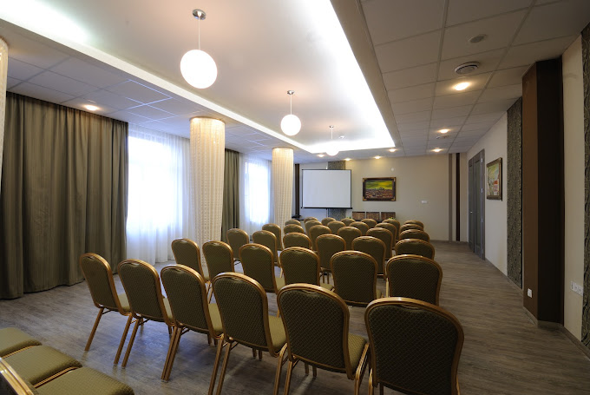
Conference rooms https://galant.cz/hotel-galant-mikulov/kongresovy-hotel/#nase-saly

Slide 5
BedRooms https://galant.cz/hotel-galant-mikulov/hotel/
Twin or Double bed room aprox. 100€/night (2475 CZK) – 75 rooms pre-booked
Single bed room 84€/night (2025CZK) – 25 rooms pre-booked
Deluxe or Premium rooms available for higher price

Slide 6
Meals
Breakfast included in price of rooms reservation
Dinner approx. 24€ (580 CZK)
Lunch approx. 18€ (440 CZK)
Coffee breaks will be included in the registration fee
Another restaurant offering traditional czech food next to the hotel - https://galant.cz/en/hotel-galant-mikulov/restaurant-and-brewery/

Slide 7
Places of Worship
Synagogue - https://www.mikulov.cz/turista/sluzby/turisticke-cile/pamatky-zidovske-komunity/synagoga
Roman-catholic church - https://www.mikulov.cz/turista/sluzby/turisticke-cile/cirkevni-pamatky/kostel-sv-vaclava
Eastern Christian church - https://www.kudyznudy.cz/aktivity/pravoslavny-chram-sv-mikulase-v-mikulove
Mosque – not in Mikulov, the closest one is in Brno or Vienna

Slide 8
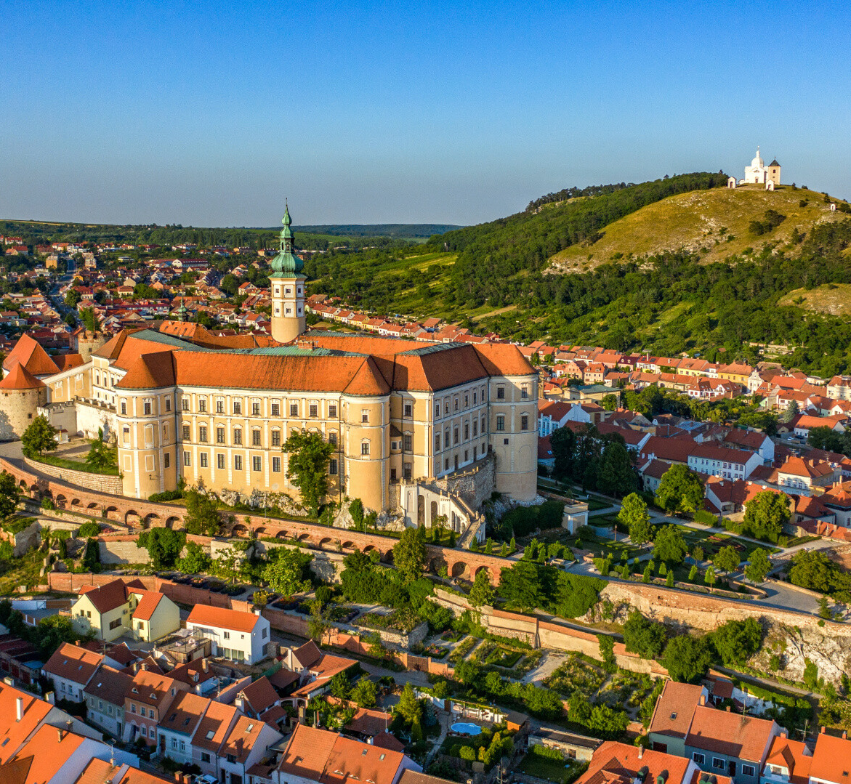
Surroundings of Mikulov
Mikulov Castle
Historical city center
Holy Hill near Mikulov
Water reservoir Nové Mlýny

Slide 9
Why would the EMER Convention be in Czech Reublic and not in Slovakia?
We didn´t find any suitable place in an affordable price range.
There is no SA in Czech Republic, altough SA felloships are active in all surrounding countries.
Since our primary purpose is to carry the message to the still suffering sexaholics (5th Tradition), this event can be seen as a great chance to bring the SA to suffering addicts in Czech Republic

